Slide 2

Applied Algorithm Lab
Balanced course assignment

Slide 3
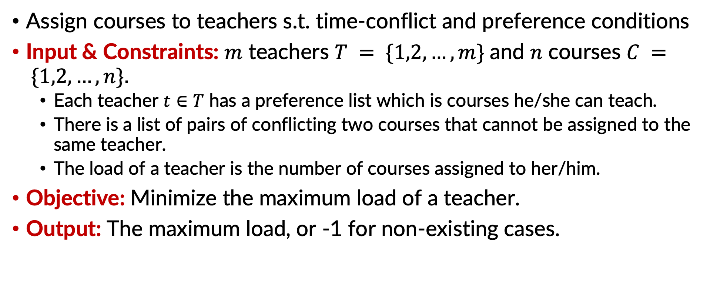
Balanced course assignment
Assign courses to teachers s.t. time-conflict and preference conditions
Input & Constraints: $m$ teachers $T = \{1,2,…,m\}$and $n$ courses $C = \{1,2,…,n\}.$
Each teacher $t∈T$ has a preference list which is courses he/she can teach.
There is a list of pairs of conflicting two courses that cannot be assigned to the same teacher.
The load of a teacher is the number of courses assigned to her/him.
Objective: Minimize the maximum load of a teacher.
Output: The maximum load, or -1 for non-existing cases.

Slide 4
Balanced course assignment
stdin | stdout
4 12 5 1 3 5 10 12 5 9 3 4 8 12 6 1 2 3 4 9 7 7 1 2 3 5 6 10 11 5 1 2 1 3 1 5 2 4 2 5 | 3 Explain: Courses of teachers: 1: 1 10 12 2: 3 4 8 3: 2 7 9 4: 5 6 11
Example

Slide 5
Balanced course assignment
Idea to solve: Backtracking and Branch and bound
To store the solution: An array Sol[N].
Sol[i] = j iff we arrange teacher j teaches subject i
To compare the objective: nbTeach[j] = number of subjects teacher j teaches
A variable maxLoad to store current solution’s maximum load
programming: write functions:
void Try(int k) // select teacher for course k
bool check(int j, int k) // check if teacher j can teach course k
void solution() // change the current solution if find a better
Branch and bound (in Try()): if one teacher has nbTeach[] larger than maxLoad: move to the bext branch.

Slide 6
THANK YOU !

